Slide 1

UNIT-6 Architectural Design
Er. Deeyoranjan Dongol

Slide 2
Architectural Design
Concerned with understanding how a software system should be organized and designing the overall structure of that system
The first stage in the software design process that link between design and requirements engineering as it identifies the main structural components in a system and the relationships between them
The output of the architectural design process is an architectural model that describes how the system is organized as a set of communicating components
Advantages of Architectural Design
Stakeholder Communication
May be used as a focus of discussion by system stakeholders
System Analysis
Analysis of whether the system can meet its non-functional requirements
Large Scale Reuse
May be reusable across a range of systems

Slide 3
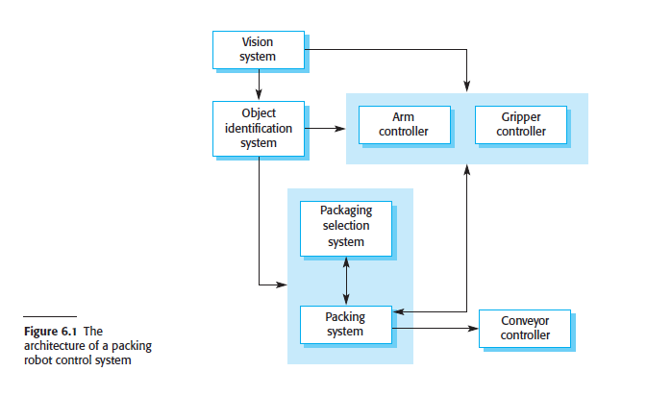
Architectural Design

Slide 4
Architectural Design Decisions
The choice of architectural style and structure should depend on the non-functional requirements of the system
Performance
The architecture should be designed to localize critical operations within a small number of components, with these components deployed on the same computer rather than distribute across the network
Security
Layered structure for the architecture should be used, with the most critical assets protected in the innermost layers and a high level of security validation applied to these layers

Slide 5
Architectural Design Decisions
Safety
The architecture should be designed so that safety-related operations are co-located in a single component or in a small number of components
Availability
The architecture should be designed to include redundant components so that it is possible to replace and update components without stopping the system
Maintainability
The system architecture should be designed using fine-grain, self-contained components that may readily be changed

Slide 6
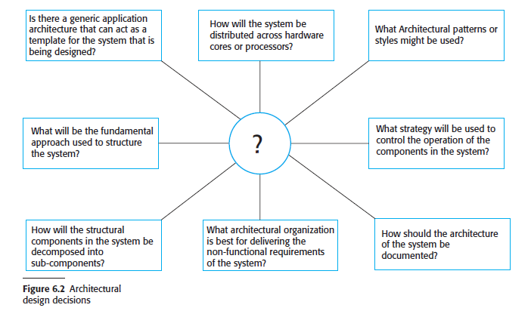
Architectural Design Decisions

Slide 7
Architectural Views
Fundamental architectural views
Logical View
Shows the key abstractions in the system as objects or object classes
Process View
Shows how at runtime, the system is composed of interacting processes
Useful for making judgments about non-functional system characteristics such as performance and availability
Development View
Shows how the software is decomposed for development
Physical View
Shows the system hardware and how software components are distributed across the processors in the system

Slide 8
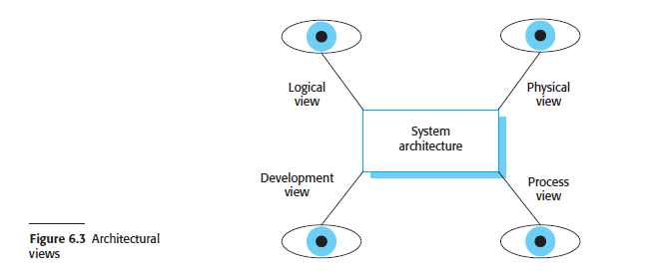
Architectural Views

Slide 9
Architectural Patterns
Stylized, abstract description of good practice, which has been tried and tested in different systems and environments
Include information on when it is and is not appropriate to use that pattern, and details on the pattern’s strengths and weaknesses
Different Architectural Patterns
Model View Controller
Layered Architecture
Repository Architecture
Client-Server Architecture
Pipe and Filter Architecture

Slide 10
Model View Controller
Separates presentation and interaction from the system data
The system is structured into three logical components that interact with each other
The Model component manages the system data and associated operations on that data
The View component defines and manages how the data is presented to the user
The Controller component manages user interaction (e.g., key presses, mouse clicks, etc.) and passes these interactions to the View and the Model
Used
When there are multiple ways to view and interact with data
When the future requirements for interaction and presentation of data are unknown

Slide 11
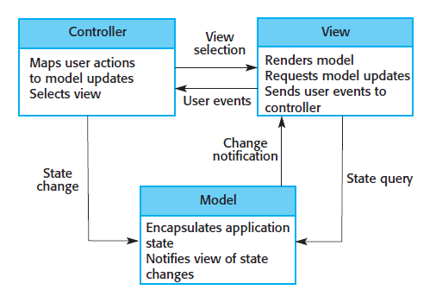

Model View Controller

Slide 12
Layered Architecture
Organizes the system into layers, with related functionality associated with each layer
A layer provides services to the layer above it, so the lowest level layers represent core services that are likely to be used throughout the system
Used
When building new facilities on top of existing systems
When the development is spread across several teams with each team responsibility for a layer of functionality
When there is a requirement for multilevel security

Slide 13
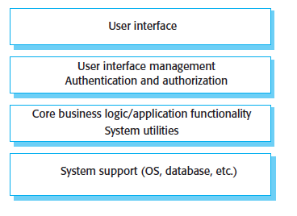

Layered Architecture

Slide 14
Repository Architecture
All data in a system is managed in a central repository that is accessible to all system components
Components do not interact directly, only through the repository
Used
When you have a system in which large volumes of information are generated that has to be stored for a long time
In Data-driven systems where the inclusion of data in the repository triggers an action or tool

Slide 15
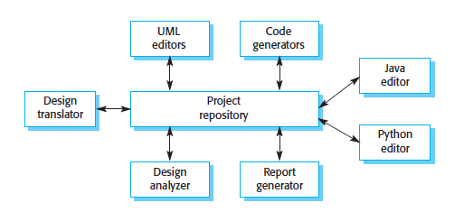

Repository Architecture

Slide 16
Client-Server Architecture
The system is presented as a set of services, with each service delivered by a separate server
Clients are users of these services and access servers to make use of them
Major components
Set of stand-alone servers which provide specific services such as printing, data management etc.
Set of clients which call on these services
Network which allows clients to access servers
Used
When data in a shared database has to be accessed from a range of locations
Because servers can be replicated, may also be used when the load on a system is variable

Slide 17
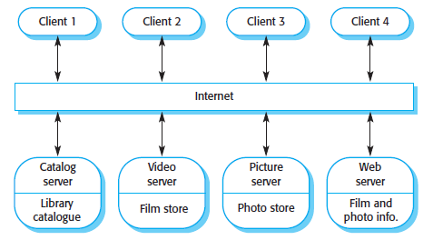

Client-Server Architecture

Slide 18
Pipe and Filter Architecture
The processing of the data in a system is organized so that each processing component (filter) is discrete and carries out one type of data transformation
The data flows (as in a pipe) from one component to another for processing
Used
In data-processing applications (both batch and transaction-based) where inputs are processed in separate stages to generate related outputs

Slide 19
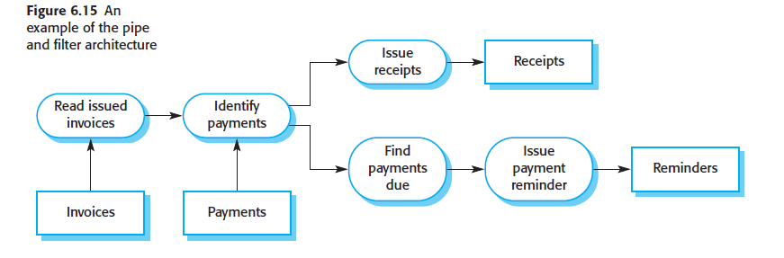
Pipe and Filter Architecture

Slide 20
Application Architectures
Encapsulate the principal characteristics of a class of systems
May be re-implemented when developing new systems
Models of application architectures can be used in a number of ways
As a starting point for the architectural design process
As a design checklist
As a way of organizing the work of the development team
As a means of assessing components for reuse
As a vocabulary for talking about applications

Slide 21
Types of Application Architectures
Transaction Processing Applications
Database-centered applications that process user requests for information and update the information in a database
Organized in such a way that user actions can’t interfere with each other and the integrity of the database is maintained
This class of system includes interactive banking systems, e-commerce systems, information systems, and booking systems

Slide 22
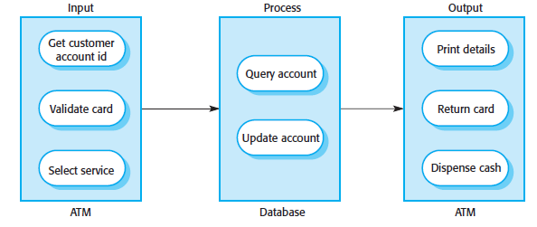

Types of Application Architectures
Transaction Processing Applications

Slide 23
Types of Application Architectures
Language Processing Systems
Systems in which the user’s intentions are expressed in a formal language, such as a programming language
Processes this language into an internal format and then interprets this internal representation
The best known language processing systems are compilers, which translate high-level language programs into machine code
However, language processing systems are also used to interpret command languages for databases and information systems, and markup languages such as XML

Slide 24
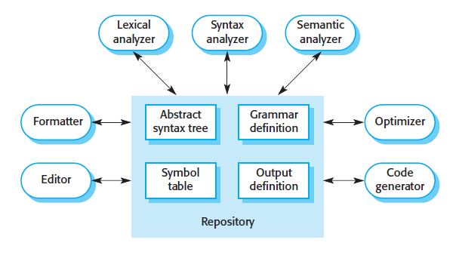

Types of Application Architectures
Language Processing Systems

